Slide 1


PIZZA SALES
DATA ANALYSIS USING SQL
PRESENTED BY
SAHIL UPADHYAY

Slide 2
Introduction:
IN TODAY'S COMPETITIVE FOOD
INDUSTRY,
DATA PLAYS A CRUCIAL ROLE
IN
UNDERSTANDING CUSTOMER BEHAVIOR, OPTIMIZING OPERATIONS, AND DRIVING SALES.
FOR A PIZZA BUSINESS, ANALYZING SALES DATA CAN REVEAL KEY INSIGHTS INTO CUSTOMER PREFERENCES, ORDER TRENDS, AND OPERATIONAL EFFICIENCIES.

Slide 3
Project Purpose:
THE AIM OF THIS PROJECT IS TO ANALYZE HISTORICAL PIZZA SALES DATA USING SQL TO PROVIDE ACTIONABLE INSIGHTS FOR THE BUSINESS. BY EXAMINING FACTORS SUCH AS POPULAR PIZZA TYPES, SALES PATTERNS, AND CUSTOMER ORDERING HABITS, THE BUSINESS CAN MAKE DATA-DRIVEN DECISIONS TO ENHANCE MARKETING STRATEGIES, IMPROVE INVENTORY MANAGEMENT, AND INCREASE OVERALL PROFITABILITY.

Slide 4
Dataset Description
Tables Overview:
Orders: Contains details of customer orders (order ID, order date, customer ID, etc.).
Order_Details: Information about pizzas in each order (order ID, pizza ID, quantity)
Pizzas: Contains pizza details like pizza ID, size, and type.
Pizza_Types: Describes types of pizzas (pizza type, ingredients, category).

Slide 5
Project Scope:
The dataset contains information on pizza orders, order details, pizza types, and sizes. We will explore and analyze these data points to answer key business questions and provide recommendations for optimizing sales performance.

Slide 6


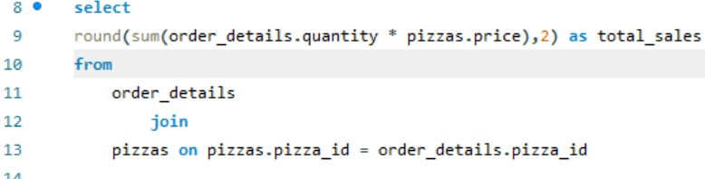

SQL Queries
1 Retrieve the total number of orders placed.
2 . Calculate the total revenue geneated from pizza sales ??

Slide 7
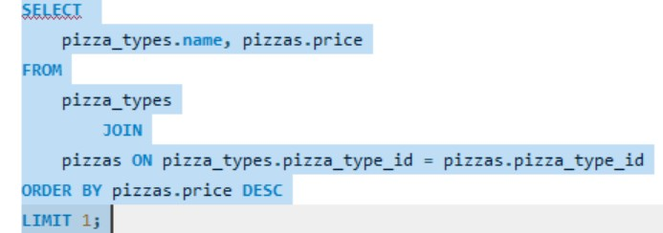

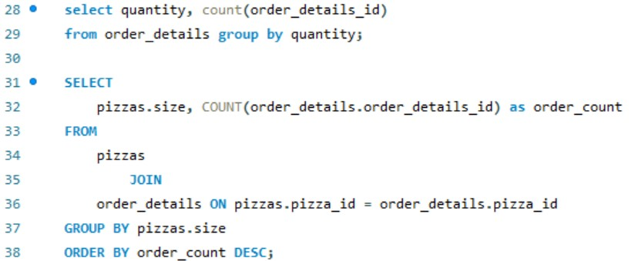
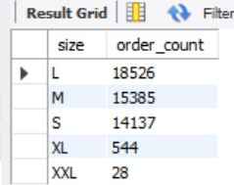
3 Identify the highest-priced pizza ?
4 Identify the most common pizza size ordered ?

Slide 8
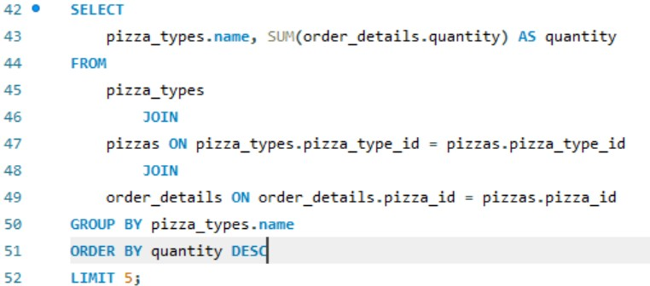
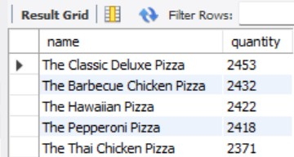
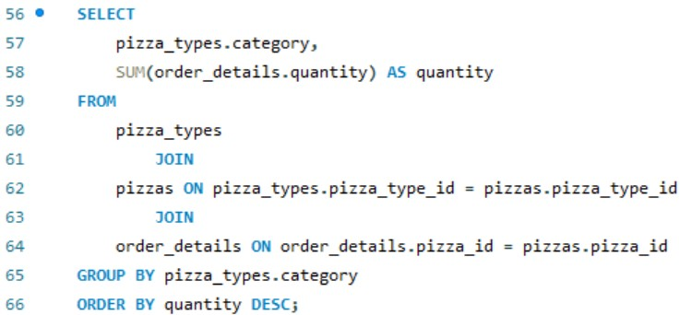
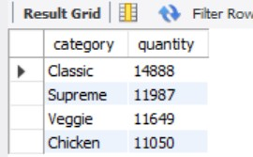
5 List the top 5 most ordered pizza types along with their quantities.
6 Join the necessary tables to find the total quantity of each pizza category ordered.

Slide 9
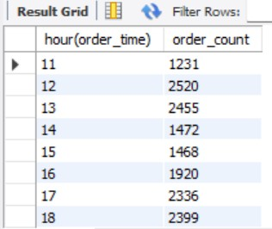

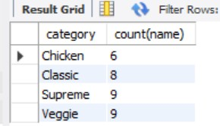
7 Determine the distribution of orders by hour of the day
8 Join relevant table to find the category wise distribution of pizzas.

Slide 10
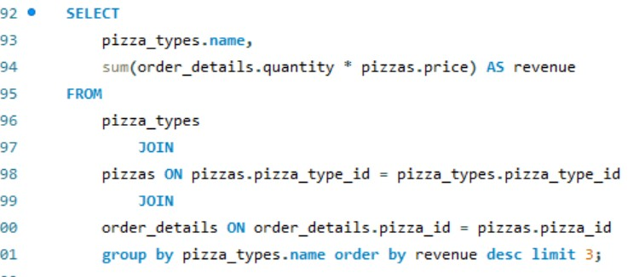
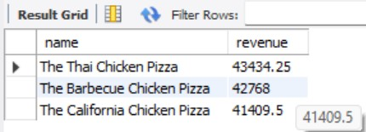
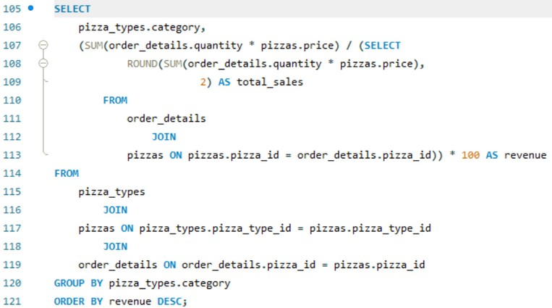
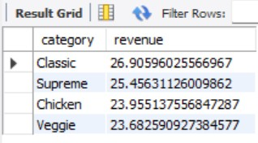
9 Determine the top 3 most ordered pizza type based on revenue.
10 Calculate the percentage contribution of each pizza type to total revenue.

Slide 11
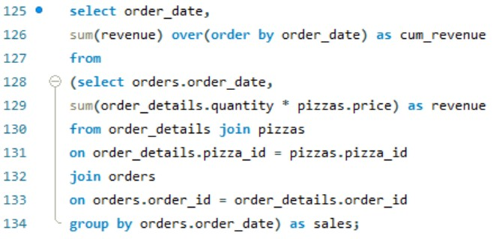
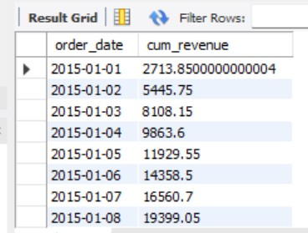
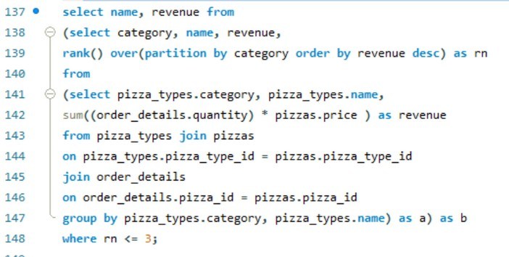
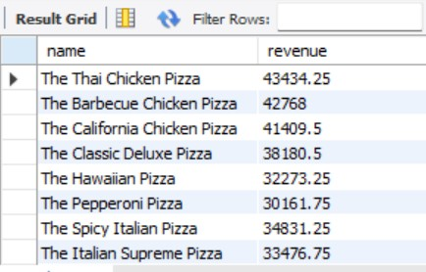
11 analyze the cumulative revenue generated over time.
12 Determine the top 3 most ordered pizza type based on revenue for each pizza category.

Slide 12
Thaannnkkk
youuu!!!

